Slide 1

CS61B
Lecture 10: Subtype Polymorphism vs. HoFs
Dynamic Method Selection Puzzle
Subtype Polymorphism vs. Explicit HoFs
Application 1: Comparables
Application 2: Comparators

Slide 2
Dynamic Method Selection Puzzle (Online Only)

Slide 3
A Typing Puzzle
Suppose we have two classes:
Dog: Implements bark() method.
ShowDog: Extends Dog, overrides bark method.
Summarizing is-a relationships, we have:
Every ShowDog is-a Dog
Every Dog is-an Object.
All types in Java are a subtype of Object.
Object
bark()
Dog
bark()
ShowDog

Slide 4
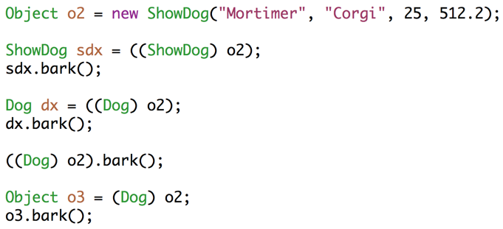
A Typing Puzzle
For each assignment, decide if it causes a compile error.
For each call to bark, decide whether: 1. Dog.bark() is called, 2. ShowDog.bark() is called, or 3. A syntax error results.
The rules:
Compiler allows memory box to hold any subtype.
Compiler allows calls based on static type.
Overridden non-static methods are selected at run time based on dynamic type.
Everything else is based on static type, including overloaded methods. Note: No overloaded methods for problem at left.

Slide 5
Static Methods, Variables, and Inheritance
You may find questions on old 61B exams, worksheets, etc. that consider:
What if a subclass has variables with the same name as a superclass?
What if subclass has a static method with the same signature as a superclass method?
For static methods, we do not use the term overriding for this.
These two practices above are called “hiding”.
It is bad style.
There is no good reason to ever do this.
The rules for resolving the conflict are a bit confusing to learn.
I decided last year to stop teaching it in 61B.
But if you want to learn it, see https://docs.oracle.com/javase/tutorial/java/IandI/override.html

Slide 6
Subtype Polymorphism

Slide 7
Subtype Polymorphism
The biggest idea of the last couple of lectures: Subtype Polymorphism
Polymorphism: “providing a single interface to entities of different types”
Consider a variable deque of static type Deque:
When you call deque.addFirst(), the actual behavior is based on the dynamic type.
Java automatically selects the right behavior using what is sometimes called “dynamic method selection”.
Curious about alternatives to subtype polymorphism? See wiki or CS164.
a.k.a. compile-time type
a.k.a. run-time type
http://www.stroustrup.com/glossary.html#Gpolymorphism

Slide 8
Subtype Polymorphism vs. Explicit Higher Order Functions
Suppose we want to write a program that prints a string representation of the larger of two objects.
Sometimes called a “callback”.
def print_larger(x, y, compare, stringify):
if compare(x, y):
return stringify(x)
return stringify(y)
Explicit
HoF Approach
def print_larger(x, y):
if x.largerThan(y):
return x.str()
return y.str()
Not to be confused with the amazing Dr. Ernest Kaulbach, who taught my Old English class.
Subtype Polymorphism Approach

Slide 9
DIY Comparison

Slide 10
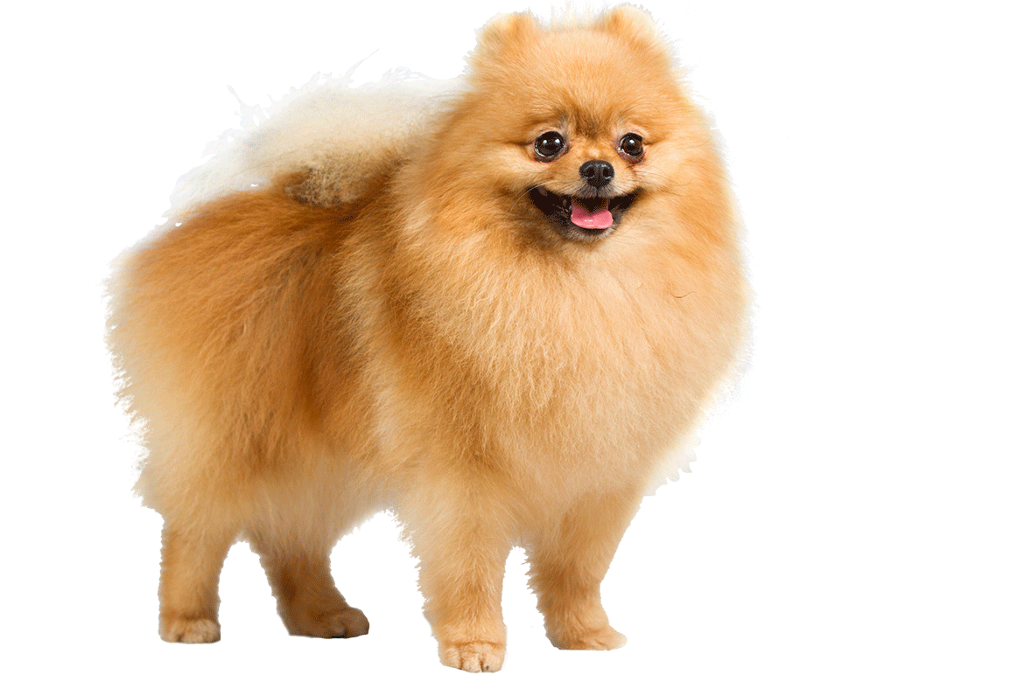


shoutkey.com/TBA
Suppose we want to write a function max() that returns the max of any array, regardless of type.
5
3
1
7
max
7
0 1 2 3
max
0 1 2
Sture
9 lbs
Elyse
3 lbs
Benjamin
15 lbs
Notes:
http://s5.postimg.org/z3o1av1lj/C_4.png
http://favoritedogbreed.com/wp-content/uploads/2015/07/Pomeranian_cutout.png
http://www.humanecharities.org.au/images/beagle.png

Slide 11
yellkey.com/yell
Suppose we want to write a function max() that returns the max of any array, regardless of type. How many compilation errors are there in the code shown?
0
1
2
3
public static Object max(Object[] items) {
int maxDex = 0;
for (int i = 0; i < items.length; i += 1) {
if (items[i] > items[maxDex]) {
maxDex = i; }}
return items[maxDex];
}
public static void main(String[] args) {
Dog[] dogs = {new Dog("Elyse", 3), new Dog("Sture", 9),
new Dog("Benjamin", 15)};
Dog maxDog = (Dog) max(dogs);
maxDog.bark();
}
Maximizer.java
DogLauncher.java

Slide 12
Writing a General Max Function
and give up on our dream of a one true max function
Objects cannot be compared to other objects with >
One (bad) way to fix this: Write a max method in the Dog class.
public static Object max(Object[] items) {
int maxDex = 0;
for (int i = 0; i < items.length; i += 1) {
if (items[i] > items[maxDex]) {
maxDex = i; }}
return items[maxDex];
}
public static void main(String[] args) {
Dog[] dogs = {new Dog("Elyse", 3), new Dog("Sture", 9),
new Dog("Benjamin", 15)};
Dog maxDog = (Dog) max(dogs);
maxDog.bark();
}
Maximizer.java
DogLauncher.java

Slide 13
Dog.maxDog
One approach to maximizing a Dog array: Leave it to the Dog class.
What is the disadvantage of this?
/** Returns maximum of dogs. */
public static Dog maxDog(Dog[] dogs) {
if (dogs == null || dogs.length == 0) {
return null; }
Dog maxDog = dogs[0];
for (Dog d : dogs) {
if (d.size > maxDog.size) {
maxDog = d; }}
return maxDog;
}
Dog[] dogs = new Dog[]{d1, d2, d3};
Dog largest = Dog.maxDog(dogs);

Slide 14
The Fundamental Problem
Objects cannot be compared to other objects with >
How could we fix our Maximizer class using inheritance / HoFs?
public static Object max(Object[] items) {
int maxDex = 0;
for (int i = 0; i < items.length; i += 1) {
if (items[i] > items[maxDex]) {
maxDex = i; }}
return items[maxDex];
}
public static void main(String[] args) {
Dog[] dogs = {new Dog("Elyse", 3), new Dog("Sture", 9),
new Dog("Benjamin", 15)};
Dog maxDog = (Dog) max(dogs);
maxDog.bark();
}
Maximizer.java
DogLauncher.java

Slide 15
Solution
interface inheritance says what a class can do, in this case compare.
Create an interface that guarantees a comparison method.
Have Dog implement this interface.
Write Maximizer class in terms of this interface.
public static OurComparable max(OurComparable[] items) { ...
OurComparable
compareTo(Object)
Dog
compareTo(Object)

Slide 16
The OurComparable Interface
Specification, returns:
Negative number if this is less than obj.
0 if this is equal to object.
Positive number if this is greater than obj.
public interface OurComparable {
int compareTo(Object obj);
}
Could have also been OurComparable. No meaningful difference.

Slide 17
General Maximization Function Through Inheritance
public interface OurComparable {
int compareTo(Object obj);
}
public class Dog implements OurComparable {
public int compareTo(Object obj) {
/** Warning, cast can cause runtime error! */
Dog uddaDog = (Dog) obj;
return this.size - uddaDog.size;
} ...
public class Maximizer {
public static OurComparable max(OurComparable[] a) {
...
}
Dog[] dogs = new Dog[]{d1, d2, d3};
Dog largest = (Dog) Maximizer.max(dogs);

Slide 18
General Maximization Function Through Inheritance
Benefits of this approach:
No need for array maximization code in every custom type (i.e. no Dog.maxDog(Dog[]) function required).
Code that operates on multiple types (mostly) gracefully, e.g.
OurComparable[] objs = getItems(“somefile.txt”); return Maximizer.max(objs);

Slide 19
Interfaces Quiz #1: yellkey.com/special
public class DogLauncher {
public static void main(String[] args) {
...
Dog[] dogs = new Dog[]{d1, d2, d3};
System.out.println(Maximizer.max(dogs));
}
}
public class Dog
implements OurComparable {
...
public int compareTo(Object o) {
Dog uddaDog = (Dog) o;
return this.size
- uddaDog.size;
} ...
Q: If we omit compareTo(), which file will fail to compile?
DogLauncher.java
Dog.java
Maximizer.java
OurComparable.java
public class Maximizer {
public static OurComparable max(
OurComparable[] items) {
...
int cmp = items[i].
compareTo(items[maxDex]);
...
}...
Notes:
DogLauncher will fail, because Maximizer expects OurComparables.

Slide 20
Interfaces Quiz #2: yellkey.com/wish
public class DogLauncher {
public static void main(String[] args) {
...
Dog[] dogs = new Dog[]{d1, d2, d3};
System.out.println(Maximizer.max(dogs));
}
}
public class Dog
implements OurComparable {
...
public int compareTo(Object o) {
Dog uddaDog = (Dog) o;
return this.size
- uddaDog.size;
} ...
Q: If we omit implements OurComparable, which file will fail to compile?
DogLauncher.java
Dog.java
Maximizer.java
OurComparable.java
public class Maximizer {
public static OurComparable max(
OurComparable[] items) {
...
int cmp = items[i].
compareTo(items[maxDex]);
...
}...
Notes:
DogLauncher will fail, because Maximizer expects OurComparables.

Slide 21
Answers to Quiz
Problem 1: Dog will fail to compile because it does not implement all abstract methods required by OurComparable interface. (And I suppose DogLauncher will fail as well since Dog.class doesn’t exist)
Problem 2: DogLauncher will fail, because it tries to pass things that are not OurComparables, and Maximizer expects OurComparables.

Slide 22
Comparables

Slide 23
The Issues With OurComparable
Two issues:
Awkward casting to/from Objects.
We made it up.
No existing classes implement OurComparable (e.g. String, etc).
No existing classes use OurComparable (e.g. no built-in max function that uses OurComparable)
public class Dog implements OurComparable {
public int compareTo(Object obj) {
/** Warning, cast can cause runtime error! */
Dog uddaDog = (Dog) obj;
return this.size - uddaDog.size;
} ...
Dog[] dogs = new Dog[]{d1, d2, d3};
Dog largest = (Dog) Maximizer.max(dogs);

Slide 24
The Issues With OurComparable
Two issues:
Awkward casting to/from Objects.
We made it up.
No existing classes implement OurComparable (e.g. String, etc).
No existing classes use OurComparable (e.g. no built-in max function that uses OurComparable)
The industrial strength approach: Use the built-in Comparable interface.
Already defined and used by tons of libraries. Uses generics.
public interface Comparable<T> { public int compareTo(T obj); }
public interface OurComparable { public int compareTo(Object obj); }

Slide 25
Comparable vs. OurComparable
OurComparable
Comparable<Dog>
compareTo(Object)
compareTo(Dog)
Dog
Dog
compareTo(Object)
compareTo(Dog)

Slide 26
Comparable Advantages
Lots of built in classes implement Comparable (e.g. String).
Lots of libraries use the Comparable interface (e.g. Arrays.sort)
Avoids need for casts.
public class Dog implements Comparable<Dog> {
public int compareTo(Dog uddaDog) {
return this.size - uddaDog.size;
}
Much better!
public class Dog implements OurComparable {
public int compareTo(Object obj) {
Dog uddaDog = (Dog) obj;
return this.size - uddaDog.size;
} ...
Implementing Comparable allows library functions to compare custom types (e.g. finding max).
Dog[] dogs = new Dog[]{d1, d2, d3};
Dog largest = Collections.max(Arrays.asList(dogs));

Slide 27
Comparators

Slide 28

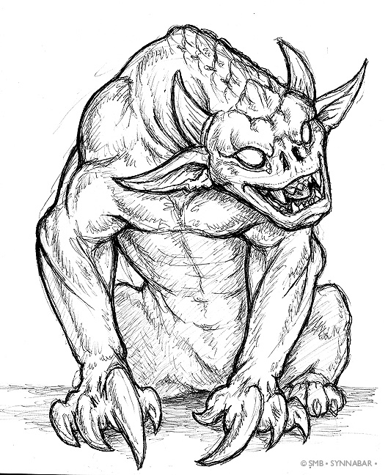
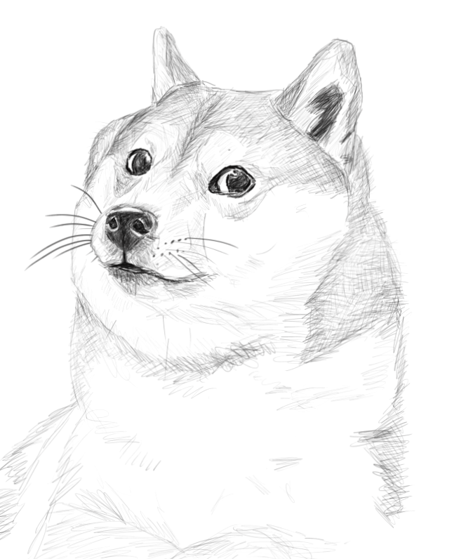
Natural Order
The term “Natural Order” is sometimes used to refer to the ordering implied by a Comparable’s compareTo method.
Example: Dog objects (as we’ve defined them) have a natural order given by their size.
“Doge”, size: 5
“Grigometh”, size: 200
“Clifford”, size: 9000

Slide 29
Natural Order
May wish to order objects in a different way.
Example: By Name.
“Doge”, size: 5
“Grigometh”, size: 200
“Clifford”, size: 9000

Slide 30
Subtype Polymorphism vs. Explicit Higher Order Functions
Suppose we want to write a program that prints a string representation of the larger of two objects according to some specific comparison function.
def print_larger(x, y, compare, stringify):
if compare(x, y):
return stringify(x)
return stringify(y)
Explicit
HoF Approach
def print_larger(T x, T y):
if x.largerThan(y):
return x.str()
return y.str()
Can simply pass a different compare function.
Subtype Polymorphism Approach??

Slide 31
Subtype Polymorphism vs. Explicit Higher Order Functions
Suppose we want to write a program that prints a string representation of the larger of two objects according to some specific comparison function.
def print_larger(x, y, compare, stringify):
if compare(x, y):
return stringify(x)
return stringify(y)
Explicit
HoF Approach
def print_larger(T x, T y, comparator<T> c):
if c.compare(x, y):
return x.str()
return y.str()
Can simply pass a different compare function.
Subtype Polymorphism Approach

Slide 32
Additional Orders in Java
In some languages, we’d write two comparison functions and simply pass the one we want :
sizeCompare()
nameCompare()
The standard Java approach: Create sizeComparator and nameComparator classes that implement the Comparator interface.
Requires methods that also take Comparator arguments (see project 1B).
public interface Comparator<T> { int compare(T o1, T o2); }

Slide 33
Dogs and Comparators
Dog not related by inheritance to any of the classes below.
public interface Comparator<T> { int compare(T o1, T o2); }
Dog
compare(T, T)
Comparator<T>
compare(Dog, Dog)
NameComparator
compare(Dog, Dog)
SizeComparator

Slide 34
Example: NameComparator
public class Dog implements Comparable<Dog> {
private String name;
private int size;
public static class NameComparator implements Comparator<Dog> {
public int compare(Dog d1, Dog d2) {
return d1.name.compareTo(d2.name);
}
}
...
}
Comparator<Dog> cd = new Dog.NameComparator();
if (cd.compare(d1, d3) > 0) {
d1.bark();
} else {
d3.bark();
}
Result: If d1 has a name that comes later in the alphabet than d3, d1 barks.

Slide 35
Comparable and Comparator Summary
Interfaces provide us with the ability to make callbacks:
Sometimes a function needs the help of another function that might not have been written yet.
Example: max needs compareTo
The helping function is sometimes called a “callback”.
Some languages handle this using explicit function passing.
In Java, we do this by wrapping up the needed function in an interface (e.g. Arrays.sort needs compare which lives inside the comparator interface)
Arrays.sort “calls back” whenever it needs a comparison.
Similar to giving your number to someone if they need information.
See Project 1B to explore how to write code that uses comparators.

Slide 36
Citations
Title screenshot from Neuromancer
How to draw a doge: http://i.imgur.com/iePIABL.png
Demon Dog: http://orig02.deviantart.net/e8fd/f/2011/154/5/e/pen_sketchbook___demon_dog_by_synnabar-d3hxrms.jpg

